Slide 1
Overview
The Tower Defence Genre are based on the player placing and upgrading “Towers” that automatically destroy enemies, thus stopping the enemies from reaching the end of a track/path.
Core Loop:
Demographic:
The Hard Fun element of Tower Defence games, tends to be more appealing to male gamers, due to “men’s drive to compete”. (Fattah, 2002). As of 2017, 59% of gamers are male, which, the Hard Fun element of Tower Defence games will appeal to. (Statista, 2017).
Place Tower
Destroy Enemies
Earn Points/Currency

Slide 2
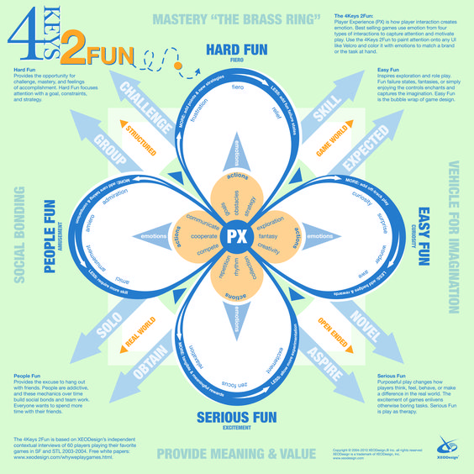
Keys of Fun:
The Tower Defence genre requires the player to participate in repetitive actions, for example, placing towers, observing enemies, upgrading towers and more. While also requiring the player to collect a form of currency.
These actions lead the player to feel emotions, like a state of Zen Focus and excitement, that are associated with Serious Fun.
In addition, the Tower Defence genre also allows the player to form strategies, overcome obstacles and achieve goals.
These actions lead the player to feel emotions, like frustration and relief, that are associated with Hard Fun.
(Lazzaro, 2010).

Slide 3
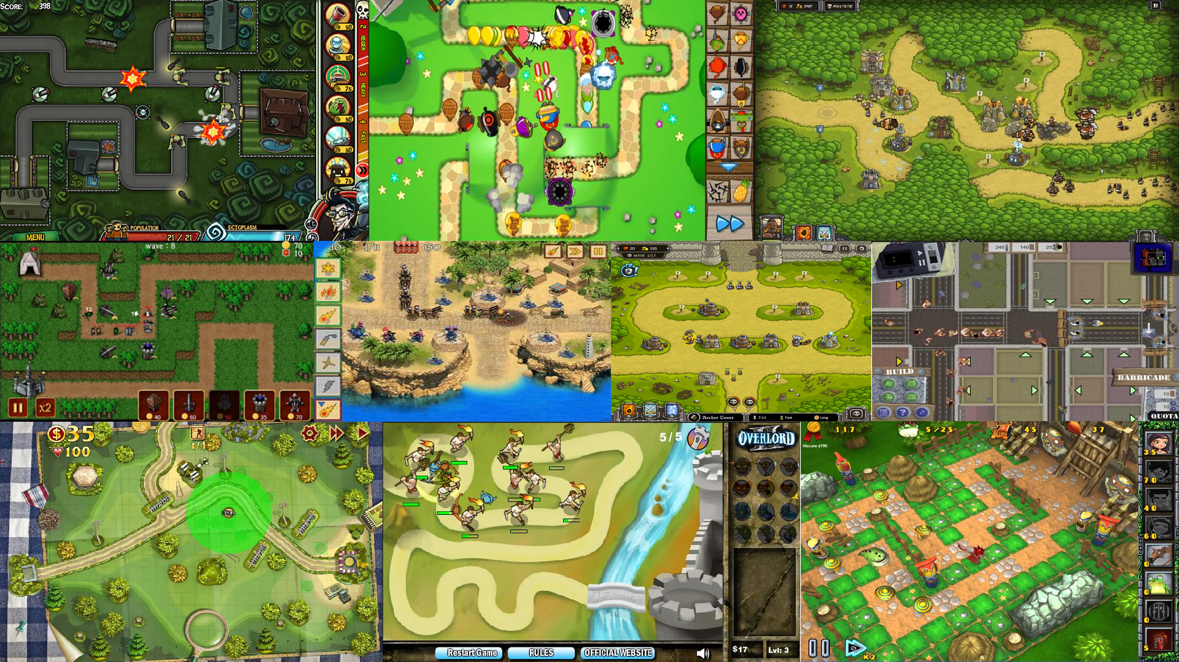
Moodboard
Consistency in UI element placement
Mostly 2D artwork
Overuse of certain themes and backgrounds
Clearly defined path

Slide 4
Concepts

Slide 5
Unique Elements
3D enemies, environments and towers.
A theme tied to an overarching narrative.
Combination with elements from other genres

Slide 6
References
Fattah, H. (2002). Gaming Gets Serious. [online] Adage.com. Available at: http://adage.com/article/american-demographics/gaming/44521/ [Accessed 7 Oct. 2017].
Lazzaro, N. (2010). The 4 Keys 2 Fun | Nicole Lazzaro's Blog. [online] Nicolelazzaro.com. Available at: http://www.nicolelazzaro.com/the4-keys-to-fun/ [Accessed 7 Oct. 2017].
Statista. (2017). U.S. video gamer gender statistics 2017. [online] Available at: https://www.statista.com/statistics/232383/gender-split-of-us-computer-and-video-gamers/ [Accessed 7 Oct. 2017].

